Slide 1



OncoSENS Updates 6/2/2017
David Halvorsen, Anne Corwin, and Haroldo Silva

Slide 2
Analysis of CC assays - Dot Blot vs EATR - U2OS gDNA in Henson lysis - 72 h exposure to 0-10,000 nM ATO

Slide 3
C-circle Detection by Fluorescence Signals (PCR-free) CC EATR Assay
This is how the CC EATR assay works:
C-circle Exonuclease III-assisted Target Recycling (CC EATR) Assay
Rolling Circle Amplification (RCA):
Detection by TaqMan Probe and Exonuclease:
5’
3’
(CCCTAA)_{n} probe
C-circle
5’
5’
3’
phi29 DNA polymerase
Probe binds
5’
ExoIII binds
+ dNTPs
+ other reagents
5’
gDNA yields, cell viability & CC normalization
Digestion of probe
Add:
PicoGreen dye
Fluorescence Detection and Target Recycling
dsDNA detection
Notes:
2/24/17

Slide 4
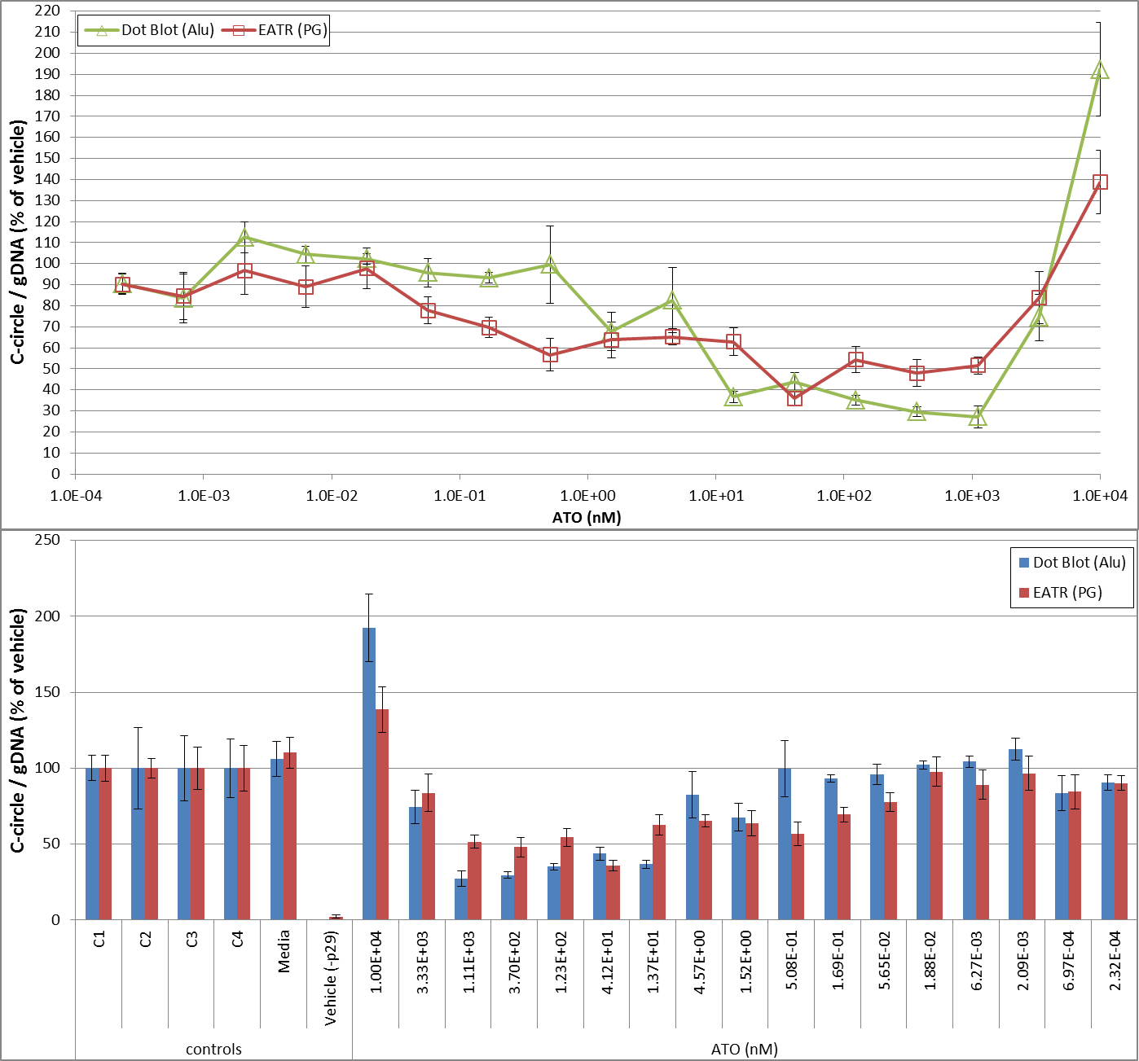
CC EATR assay-U2OS gDNA-Henson lysis-384wp,Biomek2000- 72 h exposure to 0-10,000 nM ATO-25C-60uL-24h CC EATR vs CC Dot Blot Results

Slide 5
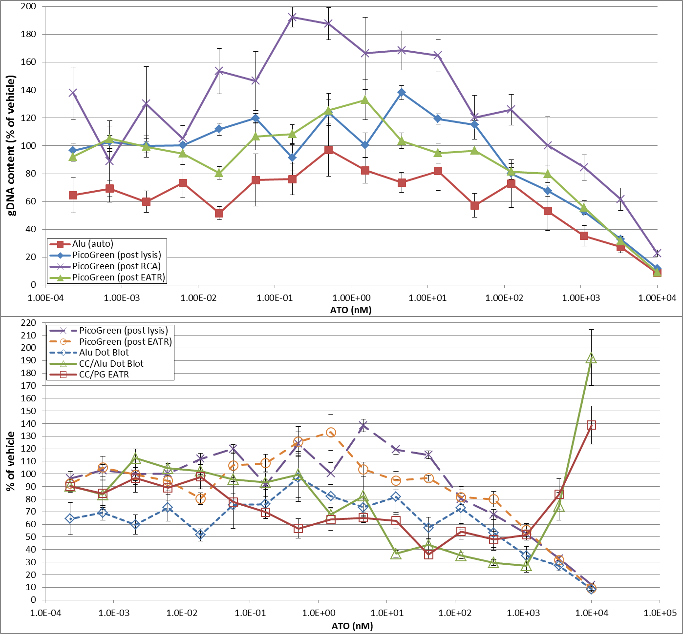
CC EATR assay-U2OS gDNA-Henson lysis-384wp,Biomek2000- 72 h exposure to 0-10,000 nM ATO-25C-60uL-24h CC EATR vs CC Dot Blot Results

Slide 6
C-circle ExoIII-based EATR Assay: Summary and Future Directions
Overall PicoGreen and Alu data show more gDNA obtained with decreasing ATO nM, as expected, with greatest toxicity occurring in the ~45-10,000 nM ATO range
It seems that the EATR reaction is virtually done (stable signals) after ~10-12 hours, as seen in the first derivative graphs of average % of vehicle and +/-p29 data
72 h of ATO exposure lowered CC content of U2OS ALT+ cells in the 0.06-3,330 nM range, with lowest CC levels achieved at 41.2 nM of ATO (below toxicity range!)
CC content increased at 10E3 nM & recovered to normal at 2E-4 to 2E-2 nM ATO while it remained below the control even outside ATO’s toxic range (0.06 to 41.2 nM)
ATO-induced inhibition of CC content was overall more pronounced in Dot Blot (20-40%) vs EATR (30-70%), in the 14-1,110 nM ATO range, compared to vehicle
But EATR data show CC inhibition gradually recovers by 0.02 nM ATO while Dot Blot data show CC content recovery is achieved by 0.5 nM ATO and at much faster rate
Overall there is excellent agreement between EATR vs Dot Blot assays, but note that samples tested in each assay were NOT exactly the same and that all samples were diluted 1:2 in blank Henson lysis buffer to achieve linear range compatibility
Notes:
2/24/17

Slide 7
Short- vs long-term exposure of cancer cells to ATO (0-10,000 nM vs 156 nM): ATPlite 1step and PicoGreen Assays

Slide 8
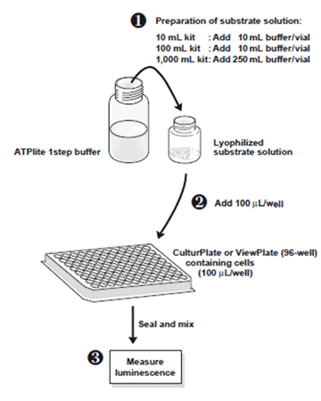
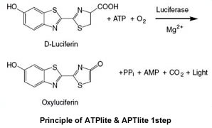
ATPlite Assay- Principle

Slide 9
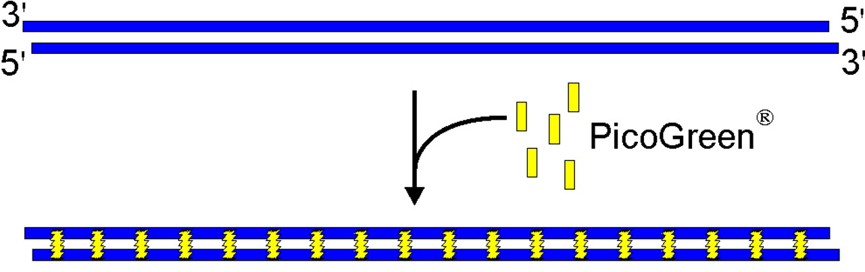
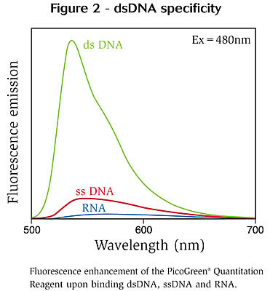
PicoGreen Assay- Principle
PicoGreen binds double-standed DNA specifically
This is performed after ATPlite 1step assay is completed

Slide 10
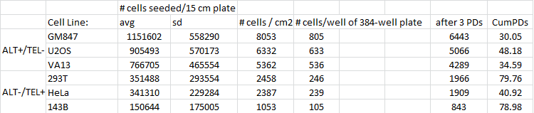
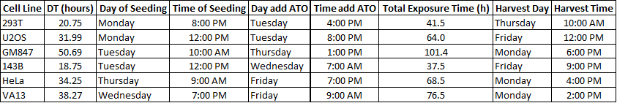
Experimental Setup
Experimental cell seeding and schedules for each cell line

Slide 11
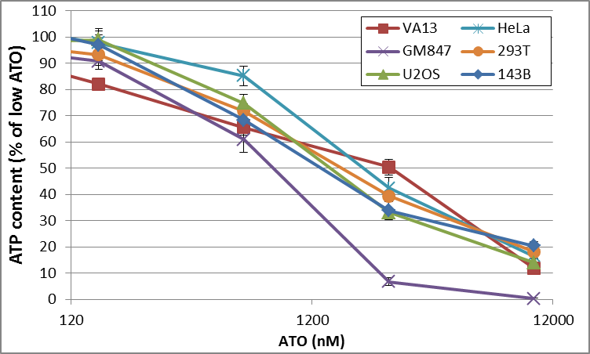
ATP content results

Slide 12
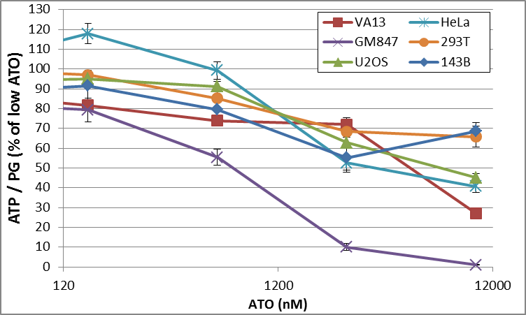
ATP content results normalized by PicoGreen

Slide 13
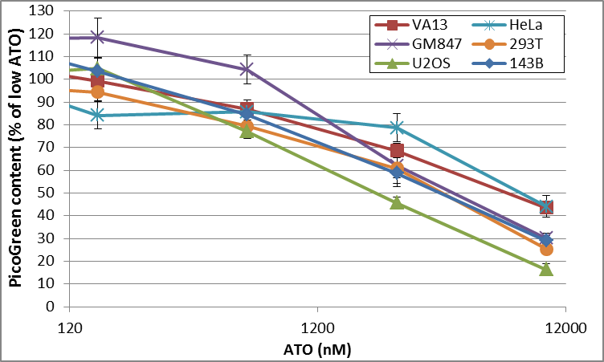
PicoGreen yield results

Slide 14
Long-term 156 nM ATO treatments – Summary and Next Steps
Telomerase-positive cells had the lowest PicoGreen and ATP yields from long-term ATO cultures vs Media or Vehicle, but that might be from cell counting errors
However, ATP/PG data show no consistent toxicity profile for any cell line from long-term 156 nM ATO cultures, which surely agrees with cell growth curve data
GM847 cells were the most sensitive to short-term ATO exposure based on raw and normalized ATP content results at high ATO concentrations (above 156 nM)
However, GM847 PicoGreen yields were not particularly lower than other cell lines
ATO was toxic to all cell lines within the 156-10,000 nM range for 2 doubling times
ATO was not particularly more toxic to any of the cell lines tested, so it did not matter if cells used telomerase or ALT for telomere maintenance/elongation
Very little toxicity was seen at 156 nM ATO, confirming long-term cell growth data
Safest non-toxic range for ATO exposures seems to be 0-39 nM, which is interesting since dramatic C-circle reduction is still observed at ~40 nM ATO (short-term 72 h)
Results show that ALT+ cancer cells are not specifically killed by ATO in the short-term (2 population doublings) or in the long term (several population doublings)
Culturing cells for longer in ATO and/or performance of colony formation assays from short-/long-term cultures might reveal ALT-/cancer-specific toxicity to ATO

Slide 15
Long Term ATO Exposure: Population Doublings

Slide 16
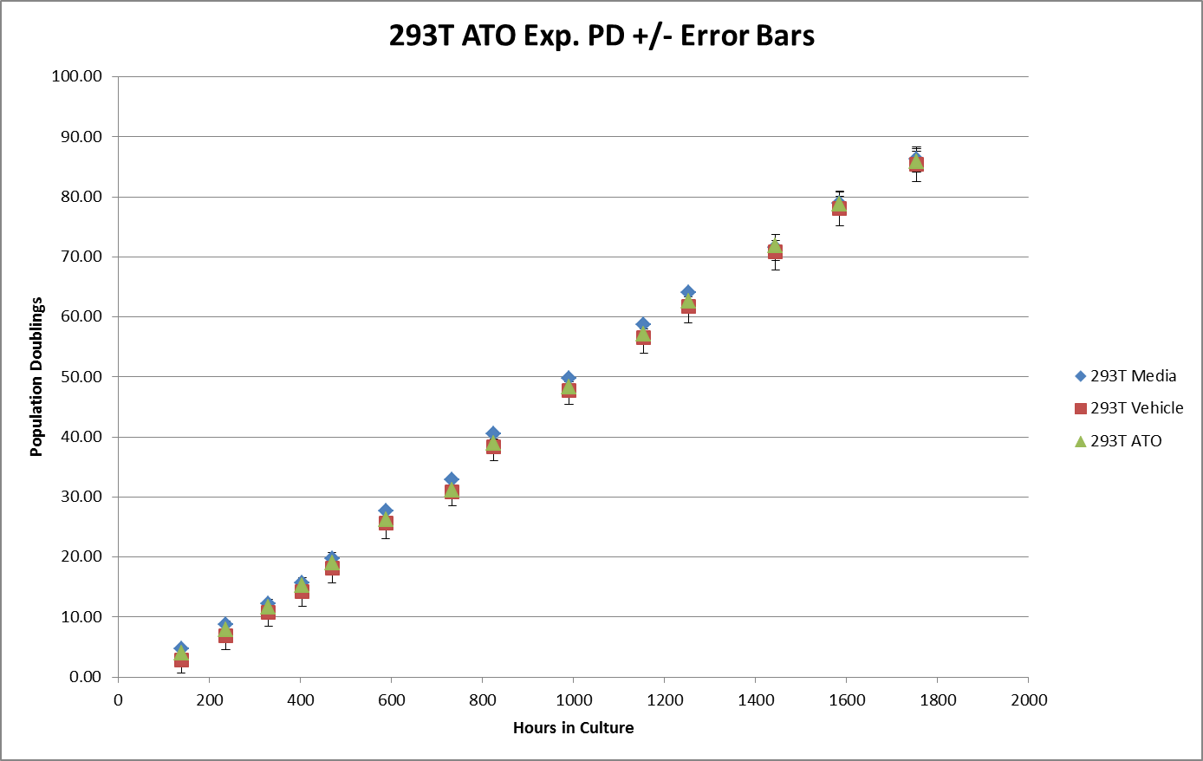
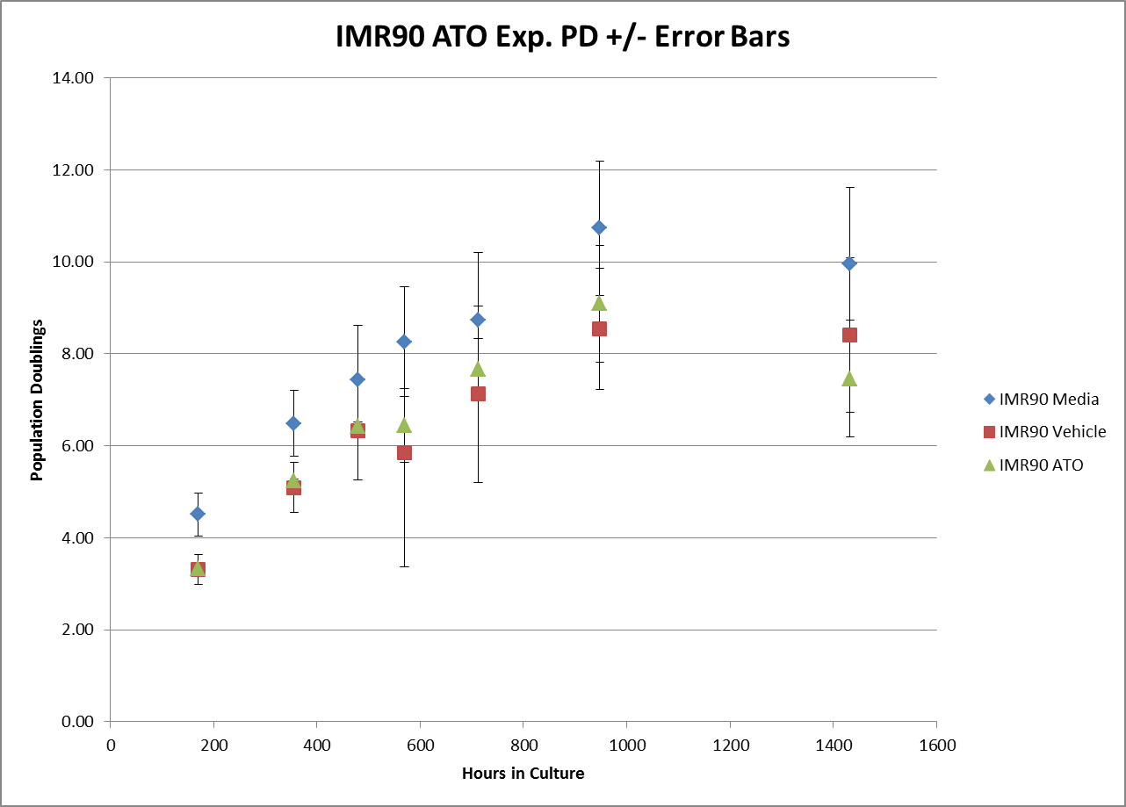
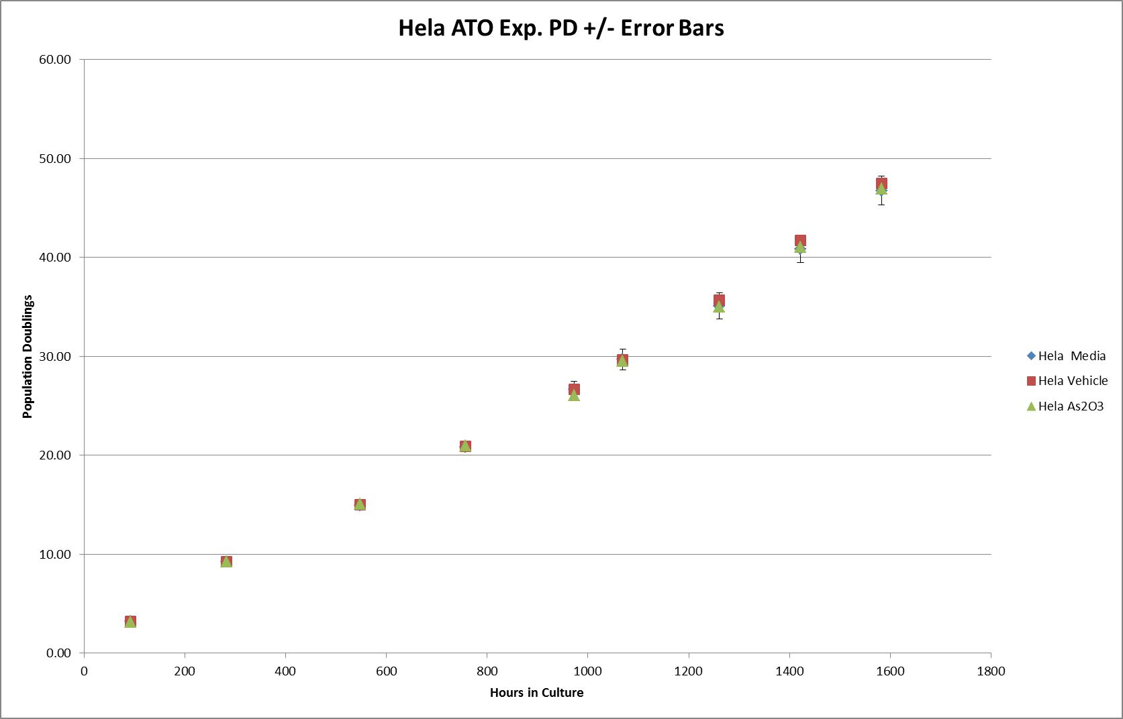
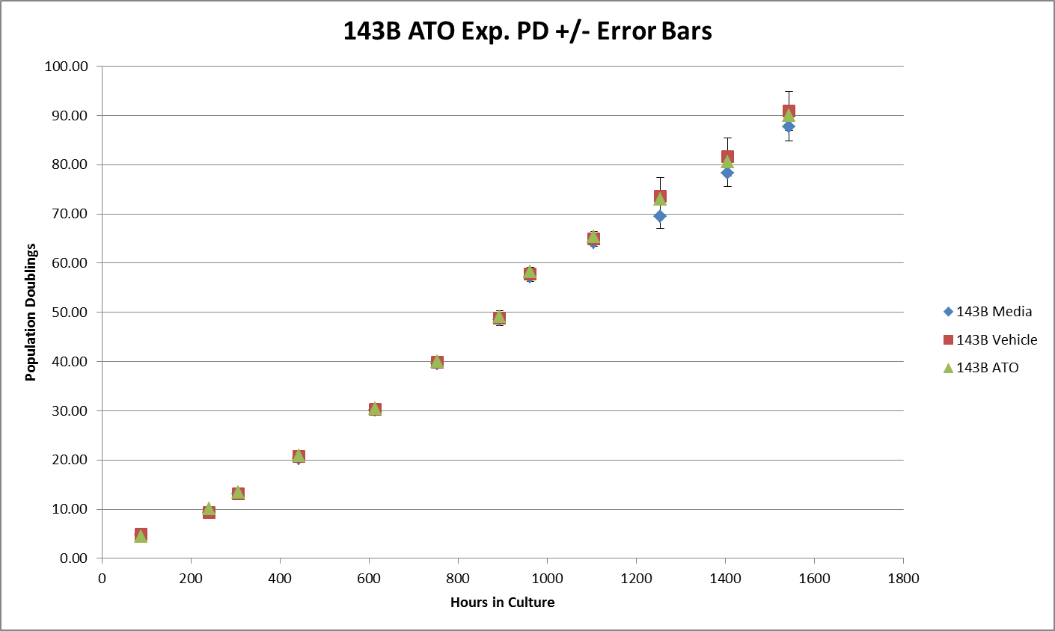
TEL&MOR LT ATO Population Doublings

Slide 17
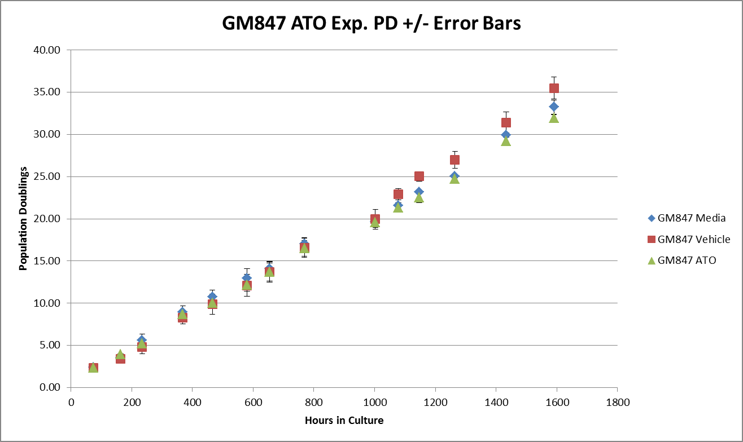
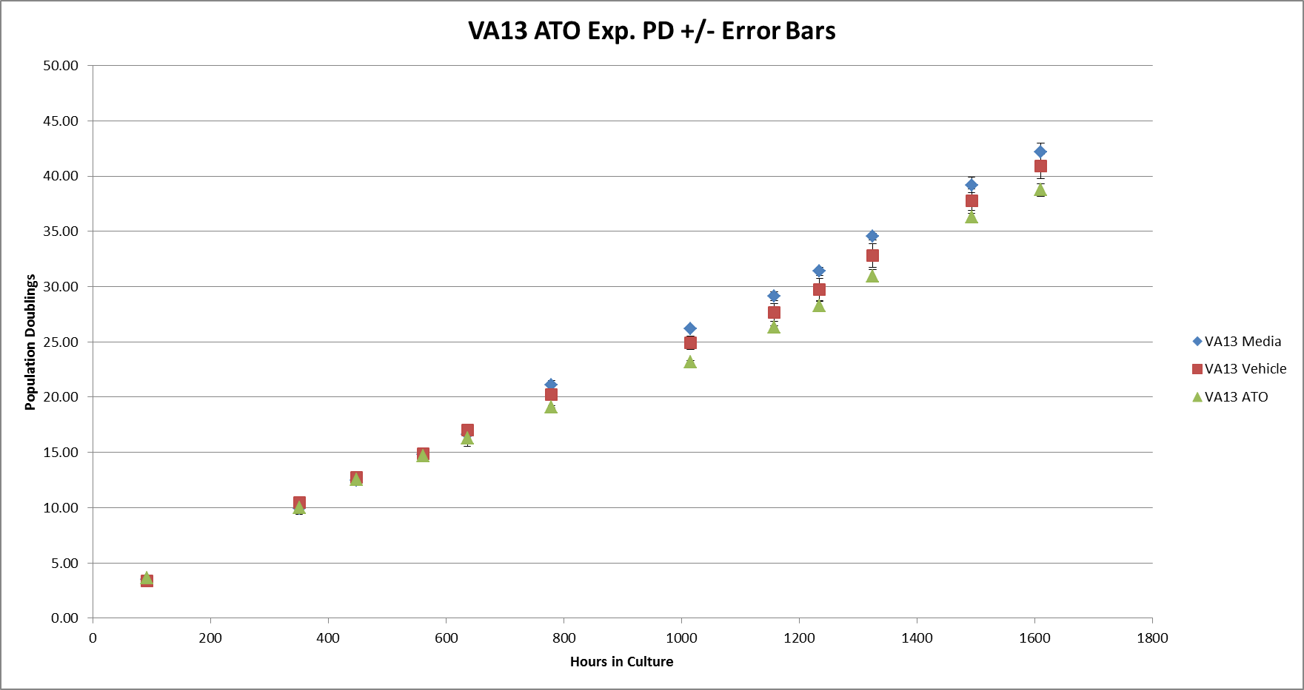
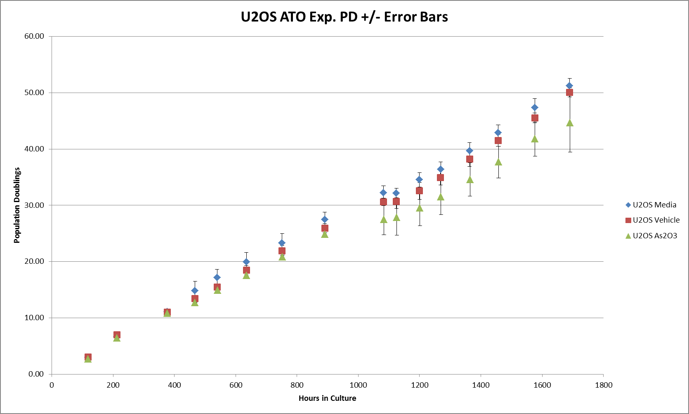
ALT Long Term ATO Population Doublings

Slide 18
LT ATO Population Doubling Summary
156 nM ATO treatment does not appear to reduce population doublings is not severely reduced in ALT cells cultured with ATO
Culturing cells for longer in ATO and/or performance of colony formation assays from short-/long-term cultures might reveal ALT-/cancer-specific toxicity to ATO
ATO likely does not act fast enough to stop a patient’s cancer

Slide 19
C-circle Dot Blot assay – 7 cell line panel – long-term exposure to 156 nM ATO #1

Slide 20
C-circle Dot Blot assay – 7 cell line panel – long-term exposure to 156 nM ATO Alu Reprobe and PicoGreen Assay: gDNA Content Results

Slide 21
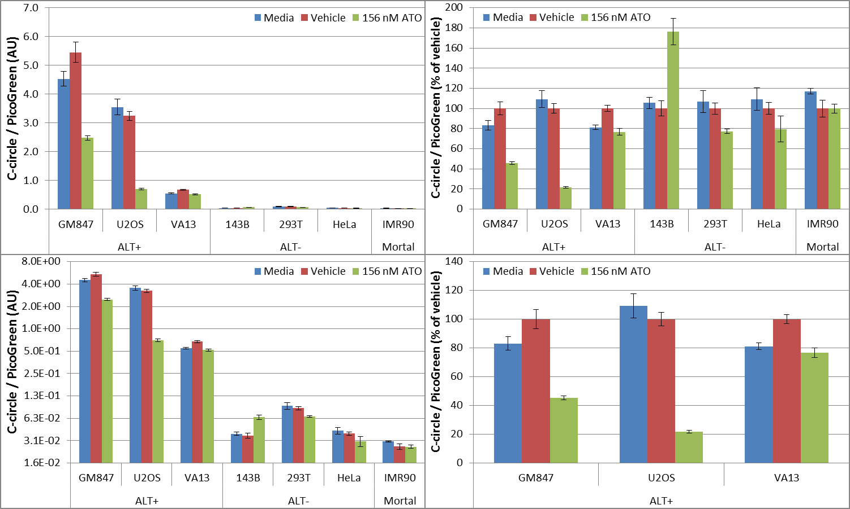
C-circle Dot Blot assay – 7 cell line panel – long-term exposure to 156 nM ATO PG-normalized C-circle signal: Auto background correction

Slide 22
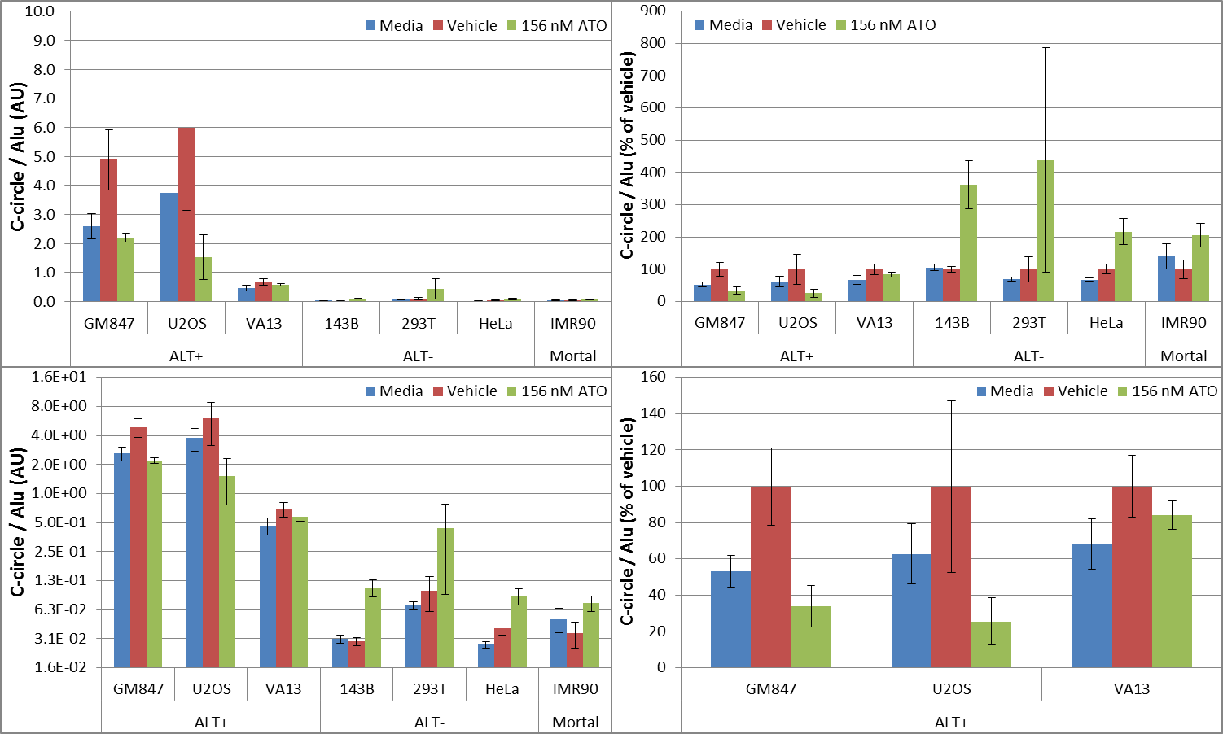
C-circle Dot Blot assay – 7 cell line panel – long-term exposure to 156 nM ATO Alu-normalized C-circle signal: Auto background correction

Slide 23
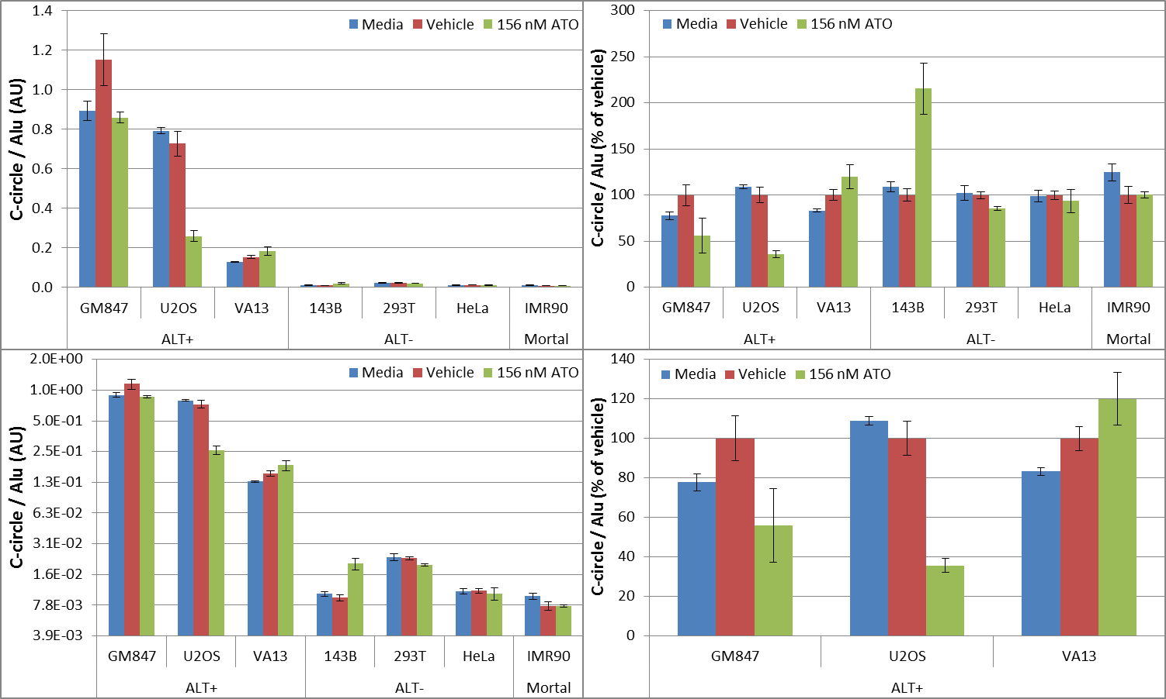
C-circle Dot Blot assay – 7 cell line panel – long-term exposure to 156 nM ATO Alu-normalized C-circle signal: Auto background correction (T-blot Alu)

Slide 24
Summary, Conclusions, and Next Steps
C-circle and Alu blots show very low background in all row H blank wells, but the Alu reprobe blot did not look high quality enough to be trusted here, so we also used T-blot Alu data
There are discrepancies in pre-blot PicoGreen vs Alu reprobe signal (see heat map patterns!)
C-circle signal normalized by PG shows very high CC levels in ALT+ vs ALT- cancer cells, as it was expected, regardless of auto vs manual dot blot data background correction
And we also see that GM847 & U2OS ALT+ cancer cells have a dramatically lower amount of CC after long-term exposure to 156 nM ATO while VA13 not so much (similar to media only)
Alu-normalized C-circle signal results agree with PG-based assessments on CC content above
293T cells had the highest amount of background in this assay out of all ALT- cell lines
The data above is consistent with the 5 cell line panel vehicle vs ATO experiment, but now that we included media only conditions, we see that CC levels are not really affected in VA13
Thus ATO causes both short-term and long-term inhibition of CC, except for VA13 ALT+ cells
The results above, combined with telomere dot blot and cell growth and ATPlite data, shows that unfortunately ATO is not an ideal candidate for the treatment of ALT cancers
But ATO can work as a good control drug for our screening assays to reliably inhibit C-circles!

Slide 25
C-circle Dot Blot assay – 7 cell line panel – long-term exposure to 156 nM ATO #2

Slide 26
C-circle Dot Blot assay – 7 cell line panel – long-term exposure to 156 nM ATO Alu Reprobe and PicoGreen Assay: gDNA Content Results

Slide 27
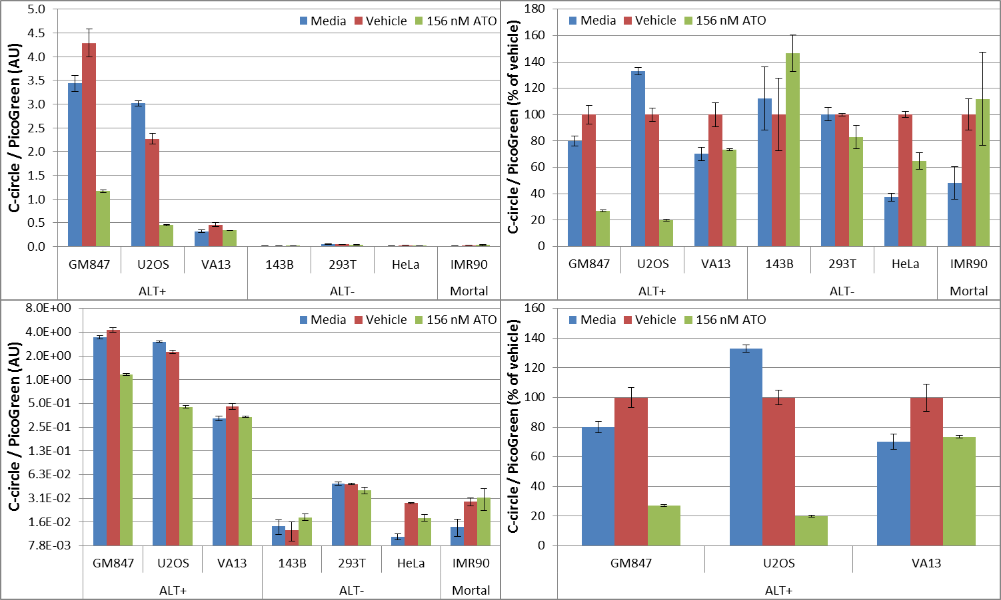
C-circle Dot Blot assay – 7 cell line panel – long-term exposure to 156 nM ATO PG-normalized C-circle signal: Auto background correction

Slide 28
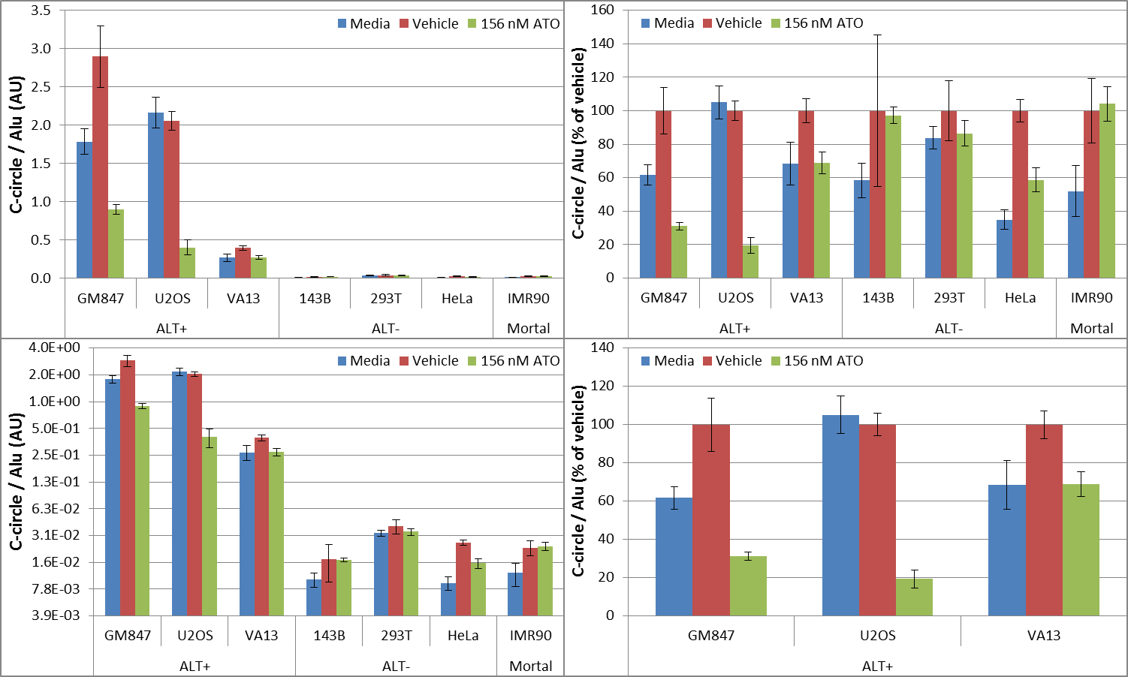
C-circle Dot Blot assay – 7 cell line panel – long-term exposure to 156 nM ATO Alu-normalized C-circle signal: Auto background correction

Slide 29
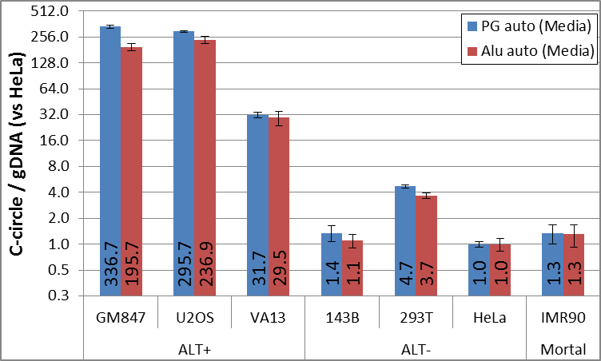
C-circle Dot Blot assay – 7 cell line panel – long-term exposure to 156 nM ATO C-circle levels normalized by PG or Alu were further normalized to HeLa (media only)

Slide 30
Summary, Conclusions, and Next Steps
C-circle and Alu blots show very low background in all row H blank wells, both at high quality, and high-exposure CC blot shows how row H background comes from RCA soup components
There are discrepancies in pre-blot PicoGreen vs Alu reprobe signal (see heat map patterns!)
C-circle signal normalized by PG shows very high CC levels in ALT+ vs ALT- cells, as expected, regardless of auto vs manual data background correction (GM847 & U2OS >> VA13)
And we also see that GM847 & U2OS ALT+ cancer cells have a dramatically lower amount of CC after long-term exposure to 156 nM ATO while VA13 not so much (similar to media ctrl)
Alu-normalized C-circle signal results agree with PG-based assessments on CC content above
293T cells had the highest amount of background in this assay out of all ALT- cell lines
The data above is consistent with the 5 cell line panel vehicle vs ATO experiment, but now that we included media only conditions, we see that CC levels are not really affected in VA13
Thus ATO causes both short-term and long-term inhibition of CC, except for VA13 ALT+ cells
The results above, combined with telomere dot blot and cell growth and ATPlite data, shows that unfortunately ATO is not an ideal candidate for the treatment of ALT cancers
But ATO can work as a good control drug for our screening assays to reliably inhibit C-circles!
ALT+ cells had 30-337 times more C-circles than HeLa (ALT-/TEL+) cancer cells
Repeat experiment above using C-circle qPCR assay (telomere length also measured here!)
Repeat Dot Blot assay for 5 cell line panel (Vehicle vs 156 nM ATO only) performed previously
Perform qPCR assay for 5 cell line panel (Vehicle vs 156 nM ATO only) tested previously by Dot Blot
Start testing HR/DDR inhibitor drugs using C-circle, telomere length assays (Dot Blot, EATR, and qPCR)

Slide 31
Total Telomeric DNA Dot Blot assay – 7 cell line panel – long-term exposure to 156 nM ATO #1

Slide 32
Total Telomeric DNA Dot Blot assay – 7 cell line panel – long-term exposure to 156 nM ATO Alu Reprobe and PicoGreen Assay: gDNA Content Results

Slide 33
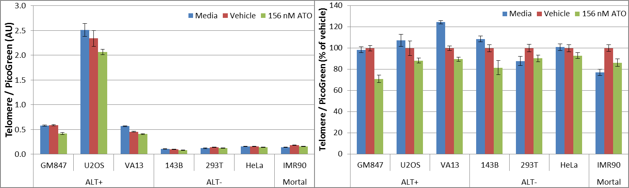

Total Telomeric DNA Dot Blot assay – 7 cell line panel – long-term exposure to 156 nM ATO PG-normalized Telomere signal: Auto (top) vs Manual (bottom)

Slide 34
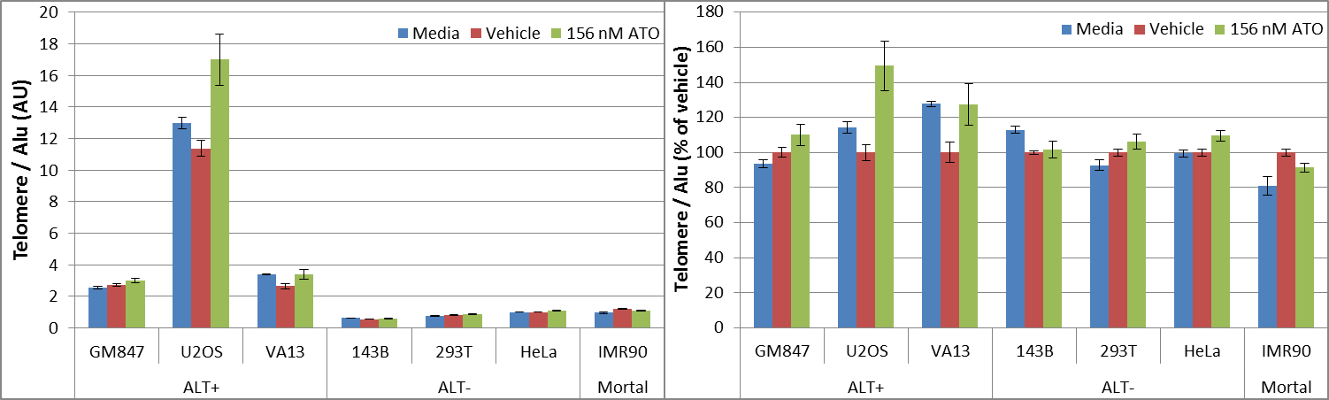

Total Telomeric DNA Dot Blot assay – 7 cell line panel – long-term exposure to 156 nM ATO Alu-normalized Telomere signal: Auto (top) vs Manual (bottom)

Slide 35
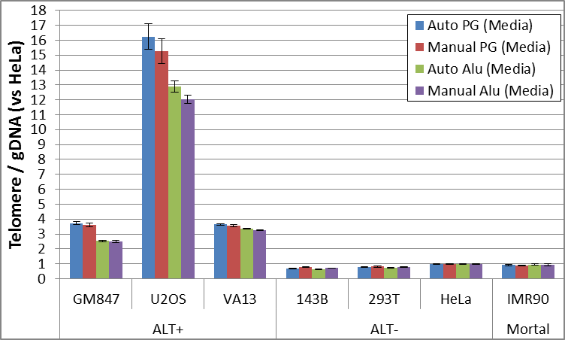
Total Telomeric DNA Dot Blot assay – 7 cell line panel – long-term exposure to 156 nM ATO Telomere signal normalized to HeLa cell line (media only)

Slide 36
Summary, Conclusions, and Next Steps
Telomere and Alu blots show very low background in all row H blank wells (optimal protocol!)
There are discrepancies in pre-blot PicoGreen vs Alu reprobe signal (see heat map patterns!)
Telomere signal normalized by PG shows an overall decrease in ATO-treated samples vs vehicle for all cell lines, regardless of auto vs manual dot blot data background correction
Overall, IMR90 cells had the largest telomere signal across conditions regardless of data normalization or background correction method (HeLa cells had 2nd highest telomere signal)
Telomere signal normalized by Alu shows an overall increase in ATO-treated samples vs vehicle for most cell lines, regardless of auto vs manual dot blot data background correction
As expected, ALT+ cell lines had significantly higher telomere signal vs ALT- cell lines regardless of data normalization or background correction method
As expected, U2OS cells had the highest telomere signal (12-16x above HeLa telomere level)
The lowest telomere signal from ALT+ cells was still about 2-3x above HeLa telomere levels
VA13 and GM847 had virtually identical telomere signal via PG normalization, but VA13 had higher telomere signal vs GM847 according to Alu-normalized results
There is no clear evidence of ATO changing telomere length in any cell line tested long term

Slide 37
Total Telomeric DNA Dot Blot assay – 7 cell line panel – long-term exposure to 156 nM ATO #2

Slide 38
Total Telomeric DNA Dot Blot assay – 7 cell line panel – long-term exposure to 156 nM ATO Alu Reprobe and PicoGreen Assay: gDNA Content Results

Slide 39
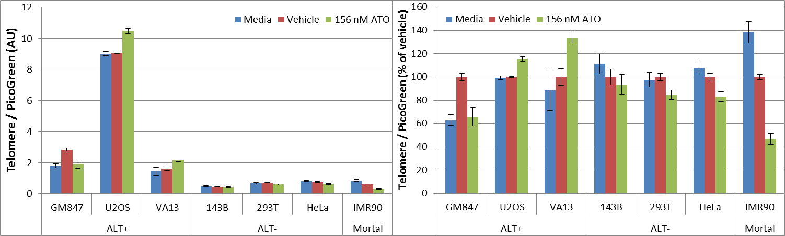

Total Telomeric DNA Dot Blot assay – 7 cell line panel – long-term exposure to 156 nM ATO PG-normalized Telomere signal: Auto (top) vs Manual (bottom)

Slide 40
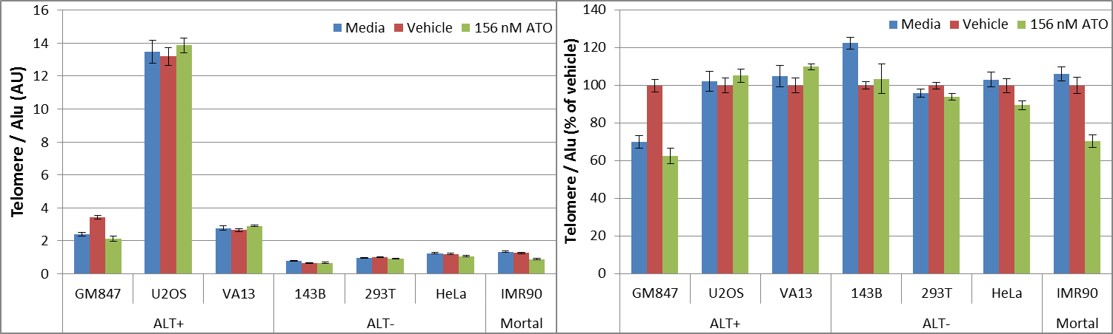
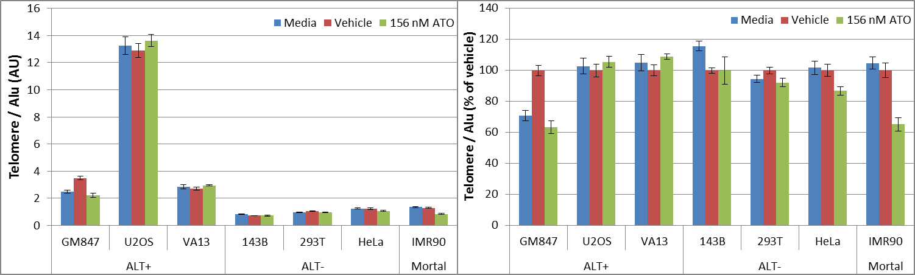
Total Telomeric DNA Dot Blot assay – 7 cell line panel – long-term exposure to 156 nM ATO Alu-normalized Telomere signal: Auto (top) vs Manual (bottom)

Slide 41
Summary, Conclusions, and Next Steps
Telomere and Alu blots show very low background in all row H blank wells (optimal protocol!)
There are discrepancies in pre-blot PicoGreen vs Alu reprobe signal (see heat map patterns!)
Telomere signal normalized by PG shows highly variable responses in ATO-treated samples vs vehicle across cell lines, regardless of auto vs manual dot blot data background correction
Overall, control IMR90 cells had the largest telomere signal regardless of data normalization or background correction method (HeLa cells had 2nd highest telomere signal)
Telomere signal normalized by Alu shows mostly no drastic changes in ATO-treated samples vs vehicle across cell lines, regardless of auto vs manual dot blot data background correction
As expected, ALT+ cell lines had significantly higher telomere signal vs ALT- cell lines regardless of data normalization or background correction method
As expected, U2OS cells had the highest telomere signal (~11x above HeLa telomere level)
The lowest telomere signal from ALT+ cells was still about 2x above HeLa telomere levels
GM847 had slightly more telomere signal vs VA13 via PG normalization, but VA13 had slightly higher telomere signal vs GM847 according to Alu-normalized results
IMR90 cells seem to have the strongest response to ATO exposure (lower telomere signal!)
There is no consistent telomere signal response to long-term exposure to 156 nM ATO in cells
Repeat experiment above using C-circle qPCR assay (telomere length also measured here!)
Repeat Dot Blot assay for 5 cell line panel (Vehicle vs 156 nM ATO only) performed previously
Perform qPCR assay for 5 cell line panel (Vehicle vs 156 nM ATO only) tested previously by Dot Blot
Start testing HR/DDR inhibitor drugs using C-circle, telomere length assays (Dot Blot, EATR, and qPCR)

Slide 42
Long Term ATO Treatment: APB Data

Slide 43
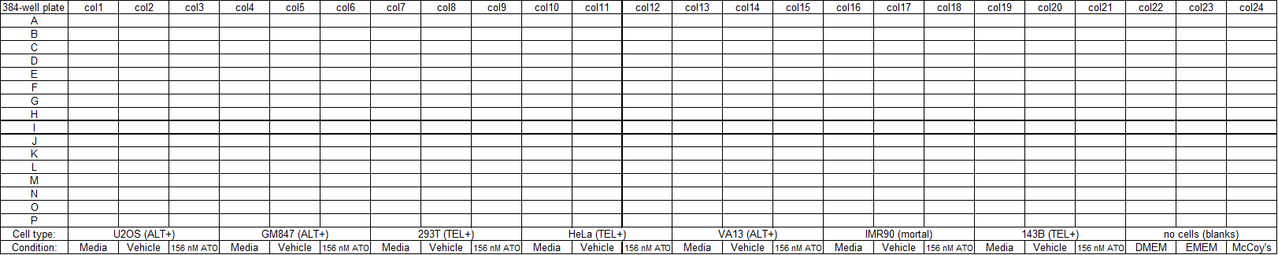
LT ATO Treatment APB Assay
APBs are known to be sites of telomere lengthening in ALT cells
Does LT ATO treatment alter APB levels?

Slide 44
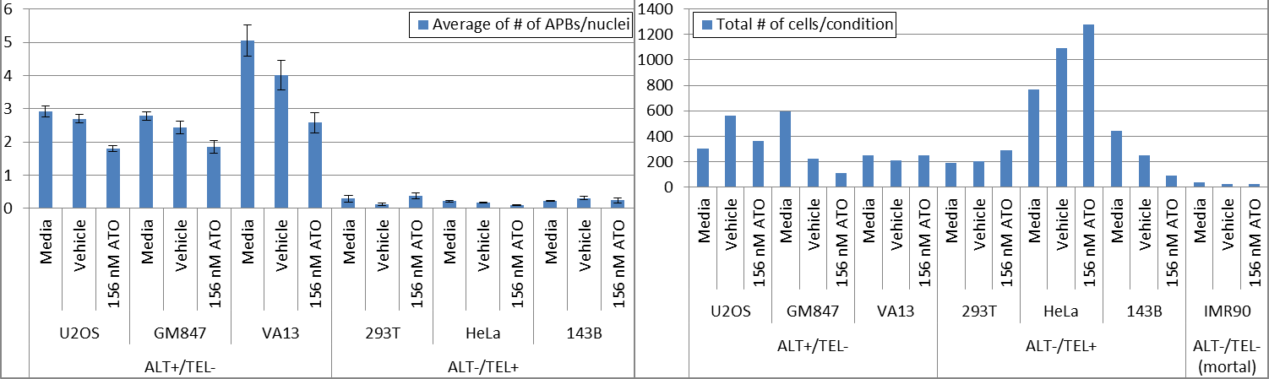
LT ATO APB Data

Slide 45
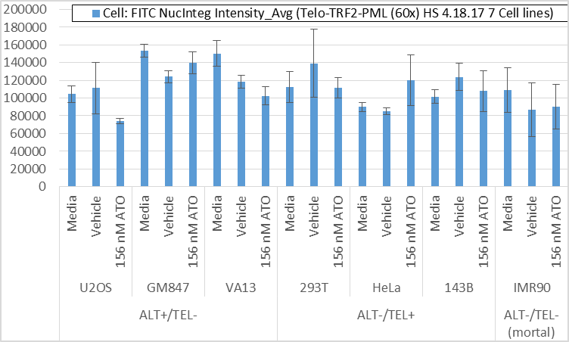
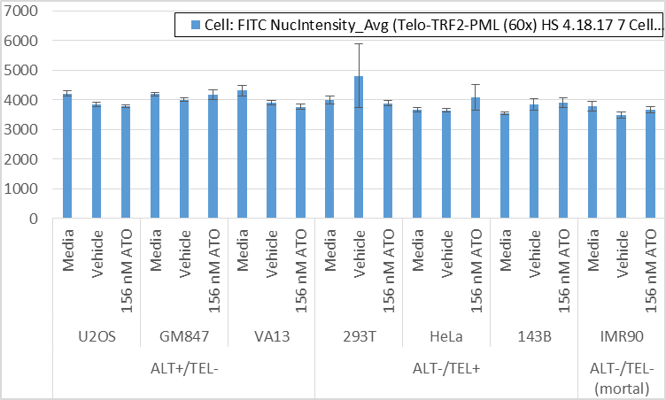
LT ATO Telomere Data

Slide 46
LT ATO APB Data Summary
It seems that long-term ATO treatment at 156 nM causes APB content to go down, which agrees with our CC assay data so far
No clear reduction in telomere signal, which agrees with the telomere dot blot data

Slide 47
TRAP 5.16.2017
David “Delightful” Halvorsen & Haroldo Silva

Slide 48

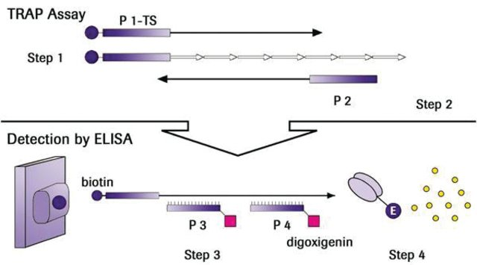
Telomerase (TRAP) Assay Workflow

Slide 49
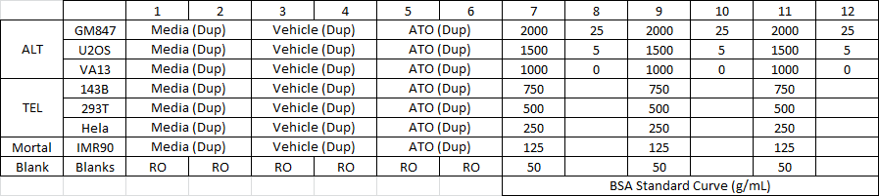
Telomerase (TRAP) Protein Quantification

Slide 50
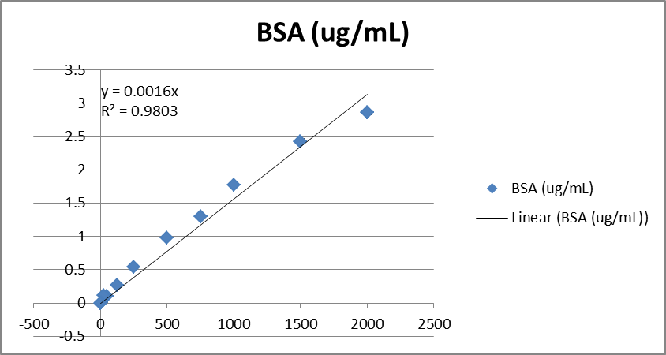
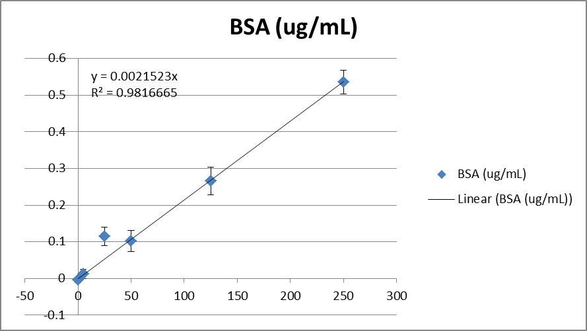
BSA Standard Curve Linear to 250 ug/mL

Slide 51
TRAP Lysate Protein Estimates (ug/uL)
Telomerase (TRAP) protocol calls for 1-50 ug/uL ☺

Slide 52
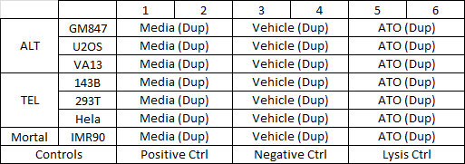
Telomerase (TRAP) Protocol
Telomerase Repeat Amplification Protocol (TRAP)
Colorimetric change @ 450 nm w/ reference @ 690 nm
Note that 3F (Hela Vehicle Duplicate) is > ½ of it’s counterpart
I believe I made a pipetting error here

Slide 53
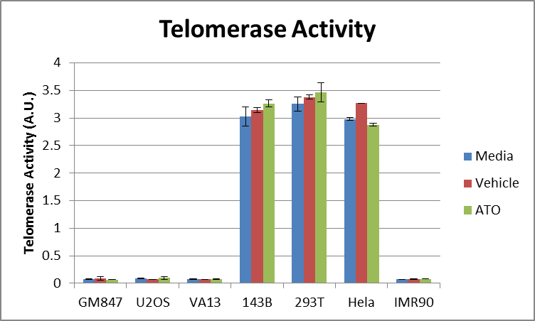
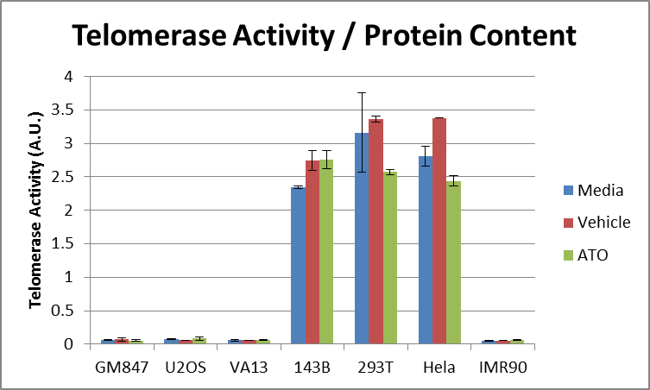
Telomerase Activity is Marginally Reduced by ATO
Red highlight is where I removed the “outlier” Hela data point
ATO causes a slight telomerase signal reduction

Slide 54
TRAP Conclusion
Protein samples were within the 1-50 ug/uL concentration requirement for the TRAP kit
There is no clear reduction in telomerase activity with ATO treatment
Normalizing by protein content shows a marginal reduction in telomerase that is likely not significant

Slide 55
qPCR Attempt 1 HS 5.21.2017
David “Delightful” Halvorsen & Haroldo Silva

Slide 56
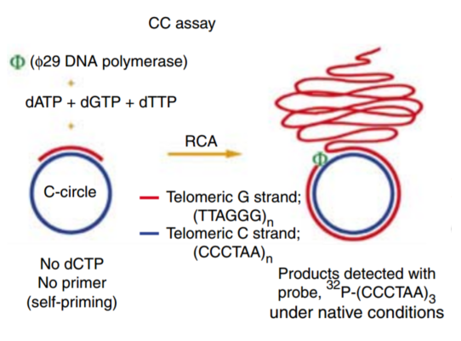
CC & Telomere qPCR Assay
+Phi29
-Phi29
qPCR Assay Telomere AND Single Copy Gene (RPLP & HBB)
qPCR Assay Telomere AND Single Copy Gene (RPLP & HBB)
Normalized telomere signal is CC & telomere end
Normalized telomere signal is telomere end

Slide 57
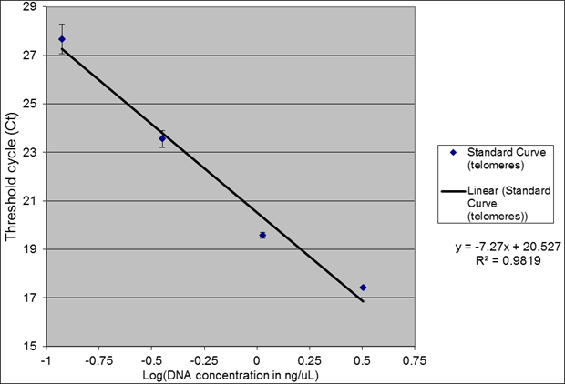
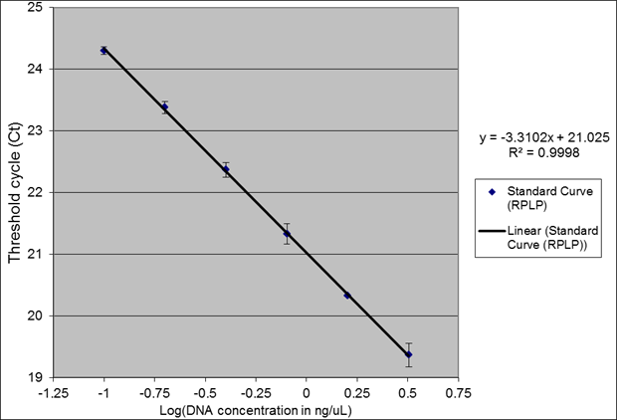
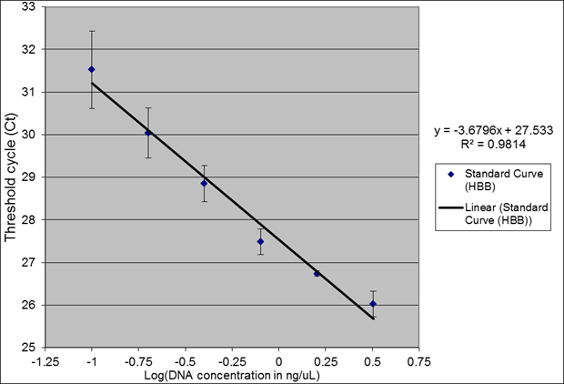
Telomere, RPLP & HBB Standard Curves

Slide 58
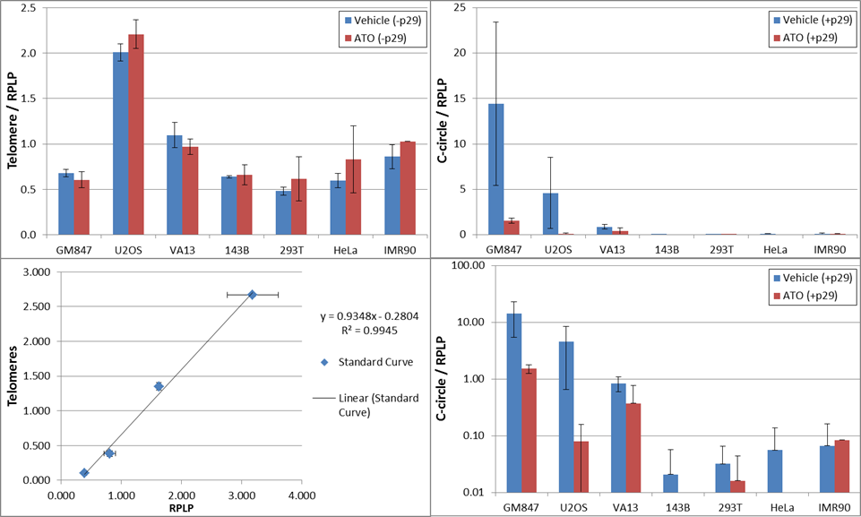
Telomere & CC RPLP Normalization

Slide 59
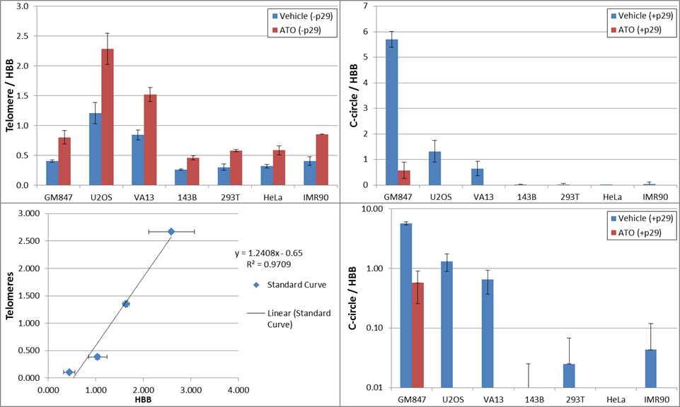
Telomere & CC HBB Normalization

Slide 60
Summary of 1st Telomeric qPCR Assay
Telomere standard curve shows very poor amplification
RPLP standard curve shows a much better amplification/PCR efficiency compared to HBB standard curve
ATO reduces C-circle levels by either normalization method (RPLP vs HBB)
But ATO does not seem to reduce telomere length in any of the cell lines tested
Actually, ATO appears to increase telomere length according to HBB-normalized data
The above agrees with C-circle Dot Blot assay data overall
U2OS has the highest telomere signal as observed previously
But GM847 cells had the highest C-circle signal, which was also seen by Dot Blot
Also, telomere length was not dramatically higher for ALT+ vs ALT- cells, contradicting Dot Blot data for the same samples
This was most likely due to the poor PCR efficiency of telomere primers in this particular experiment (better qPCR reaction protocol needed for telomere primers!)

Slide 61
qPCR Attempt 2 HS 5.25.2017
David “Delightful” Halvorsen & Haroldo Silva

Slide 62
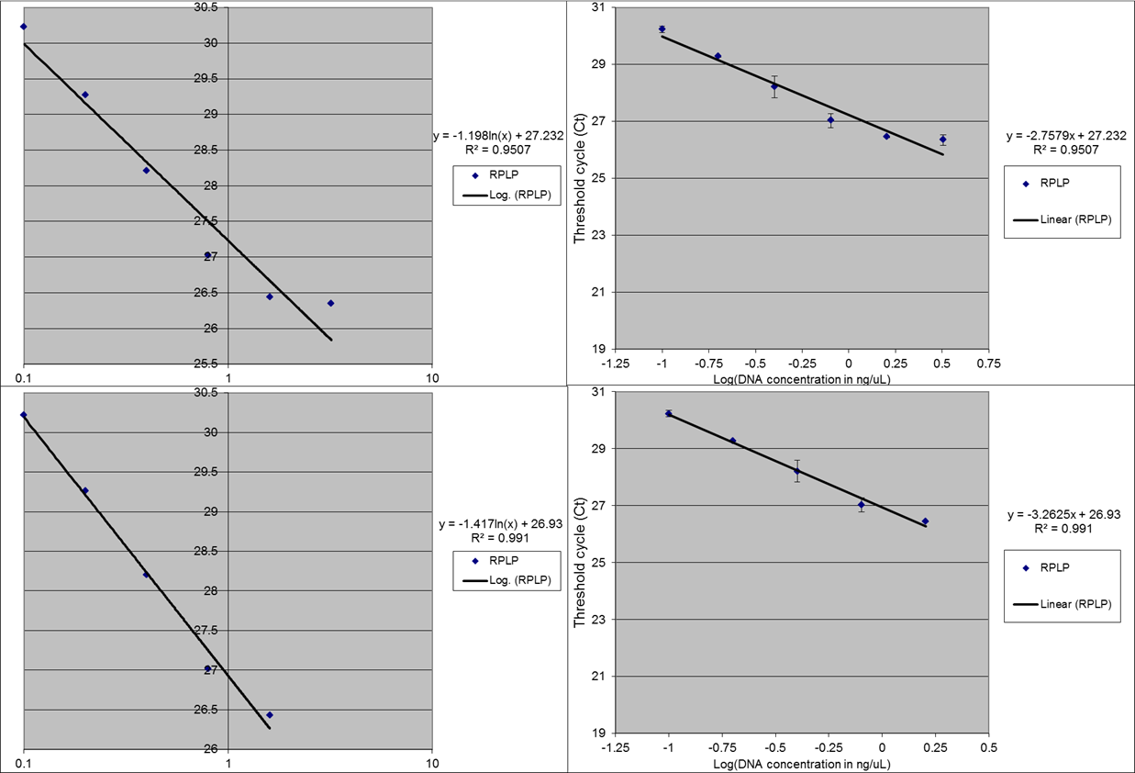
RPLP Standard Curve (DNA log scale)

Slide 63
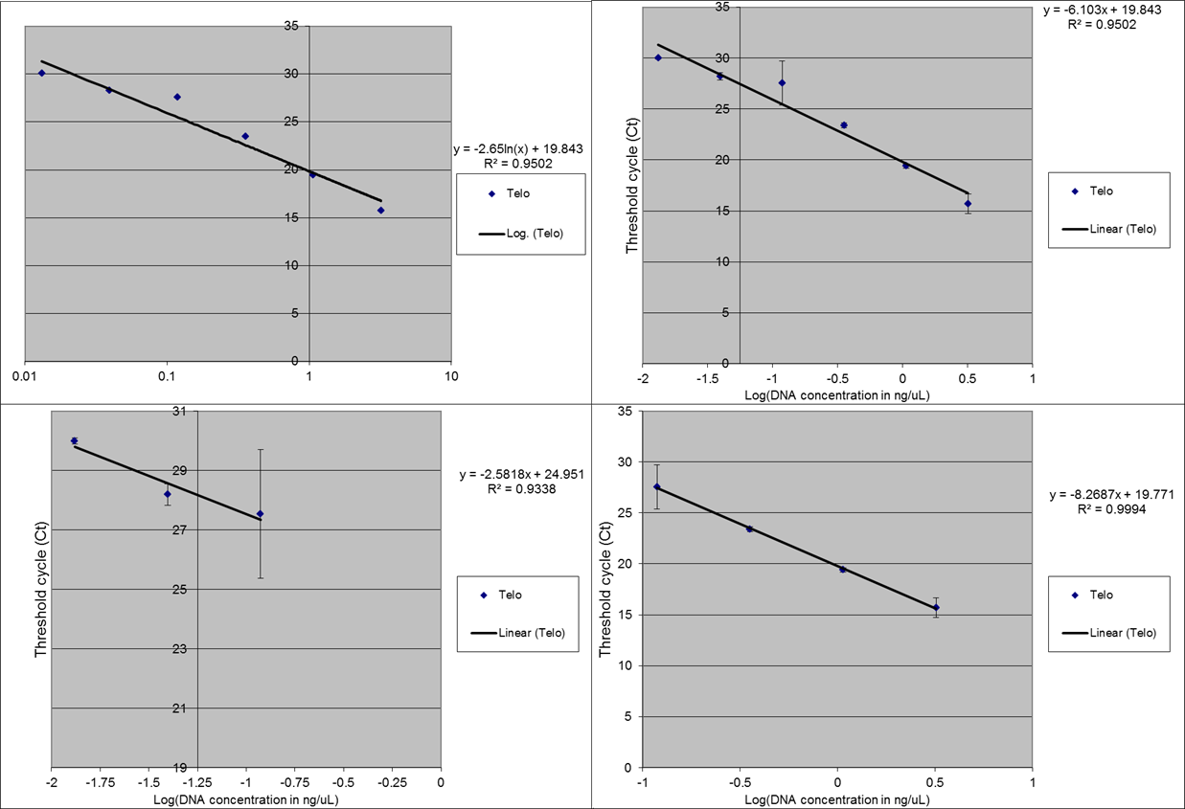
Telo Standard Curve (DNA log scale)

Slide 64
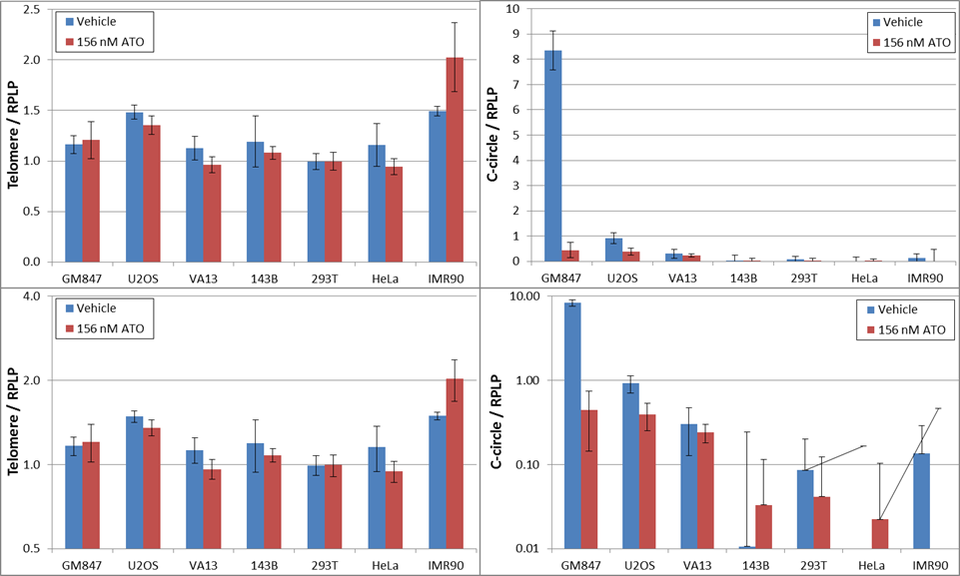
Telomere & CC Normalized by RPLP
aaaaaaaa

Slide 65
Summary of 2nd Telomeric qPCR Assay
RPLP/36B4 primer set worked well yielding near 100% PCR efficiency once the highest gDNA samples were removed from the curve
The above was probably caused by a pipetting error, which can be easily addressed during PCR reaction set up (see below)
The telomere primer set remains a problem yielding PCR efficiencies away from 100% no matter which part of the curve is examined
The telomere primer problems happened even though the PCR protocol was changed to the one described in Lau et al 2012
However, it is worth noting that the telomere primer set used, which was given to us by Jeremy Henson, is totally different from the one used by Lau et al
Normalized telomere content was not consistent with Dot Blot results since IMR90 had the highest telomere signal and no clear ALT+ vs ALT- separation observed
Normalized C-circle content revealed clear separation between ALT+ vs ALT- cell lines, as expected, but GM847 had about an order of magnitude more C-circles than U2OS, which is not consistent with Dot Blot results
Nonetheless, we do see a significant negative impact of ATO on GM847 and U2OS cells, and to a lesser extent on VA13 cells, regarding C-circle levels, consistent with Dot Blot results
VA13 had the lowest levels of C-circles among ALT+ cell lines, with GM847 having the highest, which is consistent overall with Dot Blot results
Among ALT- cells, IMR90 had the highest telomere content, which does agree with Dot Blot results

Slide 66

Fresh Vs. Frozen U2OS Standard Curve

Slide 67
Fresh Vs. Frozen Standard Curve Summary
- Making a fresh dilution standard curve right before running the assay greatly improved the linearity of the curve
- However, the PCR efficiency was still less than 100% even with freshly prepared standard curve samples
- Also, the lowest gDNA samples from new standard curve did not generate any amplification (not really sure why...)
- Experiment definitely needs to be repeated before advancing to the telomere primer set optimization
- We can try the exact PCR protocol described in Lau et al 2012 for RPLP/36B4 (we are using the exact same primers!)
- We can also try adding samples first, then qPCR reaction mix before plate centrifugation (reduce time mix is just sitting on plate +/- gDNA samples)
- Maybe it is better to transfer all samples into 96-well qPCR plate first, then make qPCR reaction mix, then add it to plate (switch tips between every addition!)

Slide 68


RPLP Lau Protocol w/ Samples 1st is Best

Slide 69


RPLP Lau Protocol w/ Samples 1st is Best

Slide 70


Searching for Optimal Telomere qPCR Protocol
aaaaaaaa

Slide 71
qPCR Summary
The standard curves need to be optimized before repeating the qPCR assay for telomere length & CC content
Freshly prepared curves have better linearity
RPLP Lau protocol with samples added 1st is optimized
Telomere protocol needs improvement
Henson & Lau temperature protocols
Lowered primer conc. & added DMSO & DTT
Recommendations?
Get different PCR Master Mix?

Slide 72
Jeremy’s Microarray Data
Microarray identified 250 differentially expressed genes from 12 ALT & 12 TEL
Are any of these genes ALT critical?
Could we use these to target ALT with suicide genes, immunotherapy or drugs?
NSBP1 is of interest
~order of magnitude higher in ALT
Chromatin binding protein
QIAGEN has siRNA for this
This might be a druaggable target

Slide 73

JH Microarray Data: NSBP1

